Slide 1



By,
Chandhana Menon
1NH17CS712

Slide 2
Objective of Course
To understand and apply the gain theoretical knowledge of Java language to model the real world applications using Object Oriented Programming concepts
To develop applications using inheritance.
To learn and implement the syntax and features of exception handling and multithreading
To understand how to develop and implement swing applications.
To analyse and apply the JDBC concepts and create applications based on database.

Slide 3

What is SPUR ?
An HRMS Java Application developed for performing the analysis of a payroll of a company over a period of time efficiently, to improve the profits of an organization. The live dashboard gives the latest information of the payroll details, which can help plan a future course.

Slide 4
Methodology
The initial step is to analyze the problem statement of the project and come up with ideas to implement it.
Create a database in WAMP that can store all the information from the front end into the JDBC.
Various windows in front end is created to fulfil the required functionalities that has to be carried out by the project.
Connect each UI page to the JDBC. The front-end will act as the intermediate and the user. Setup action-listers in order to perform the certain actions.
Perform the calculations in the back-end and the store it in a table. Retrieve those stored values on the front end as and when required.
Use graph to do the analysis. Use a graph to pictorially represent the data store in the tables in the JDBC.

Slide 5

Employee Management
Employee management helps in increasing employee engagement and ultimately impact the growth of the organization .
An organization to handle payroll duties in house through a manual process could be time consuming while attempting to calculate everything correctly.
One miscalculation and the business owner could find themselves in legal or financial trouble. So SPUR could be solution for organizations as its payroll system.

Slide 6
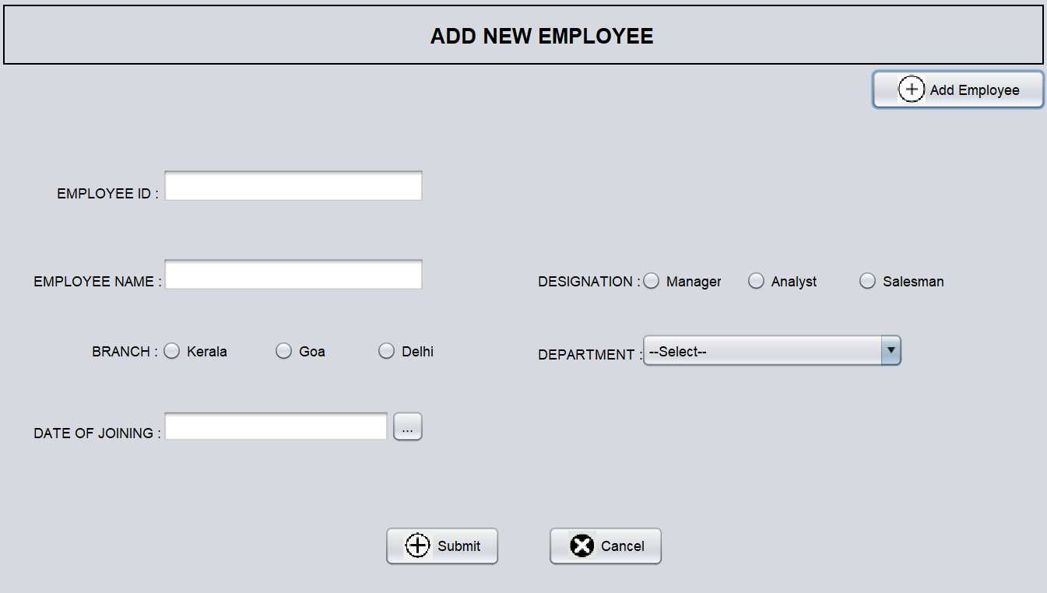
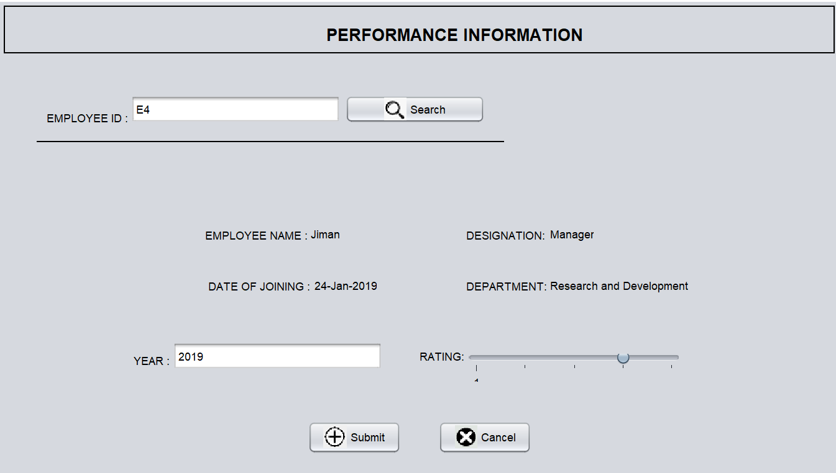
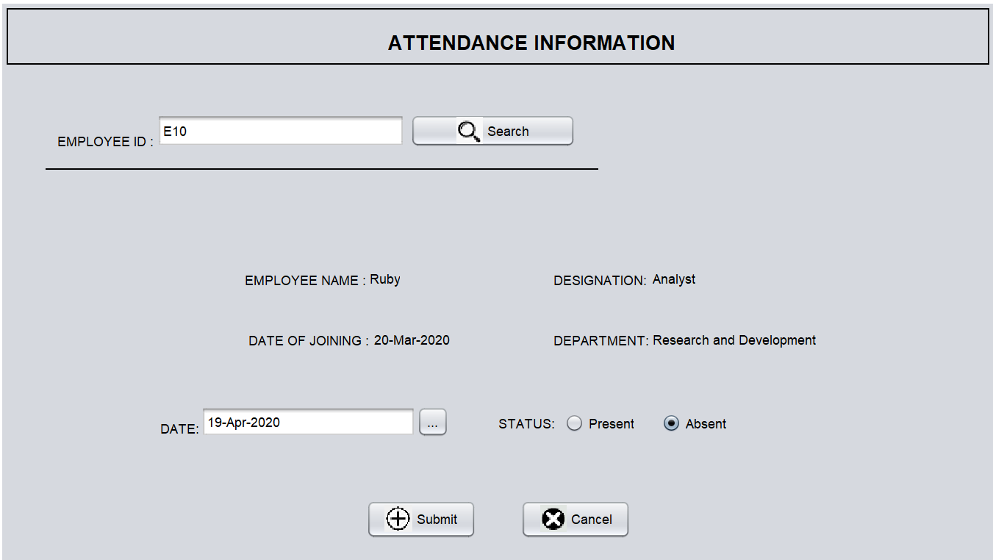
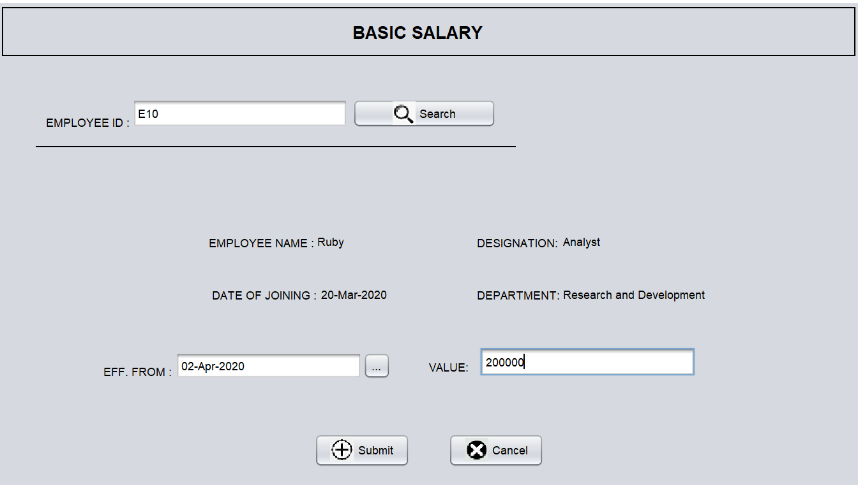

Slide 7
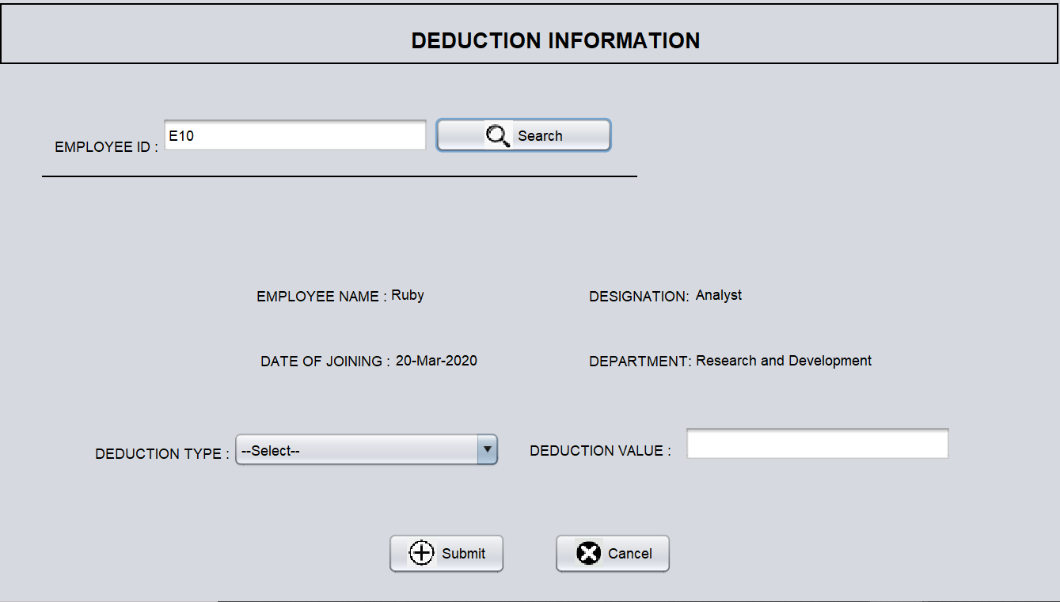
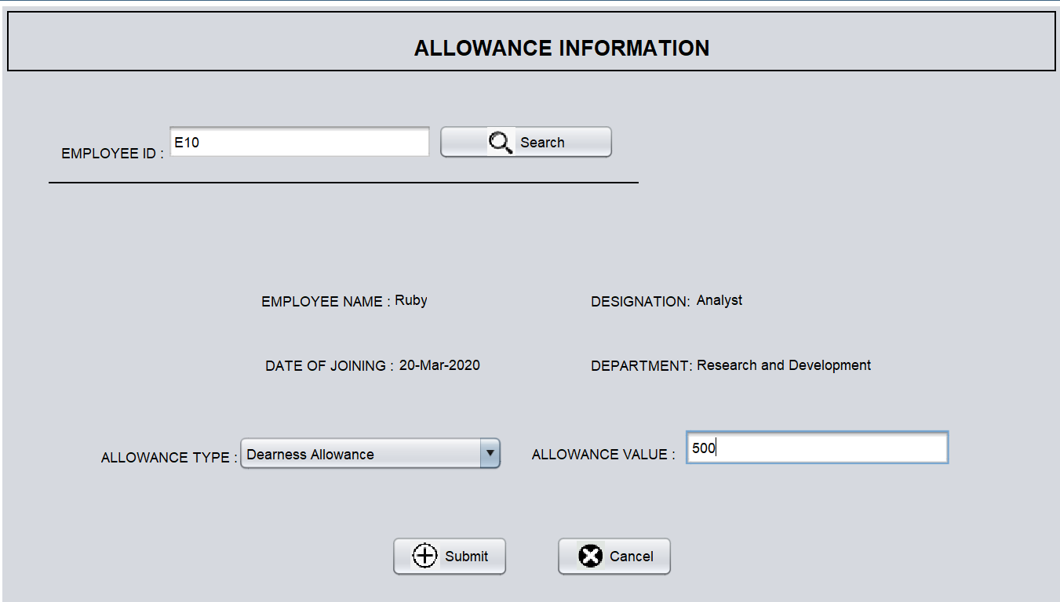
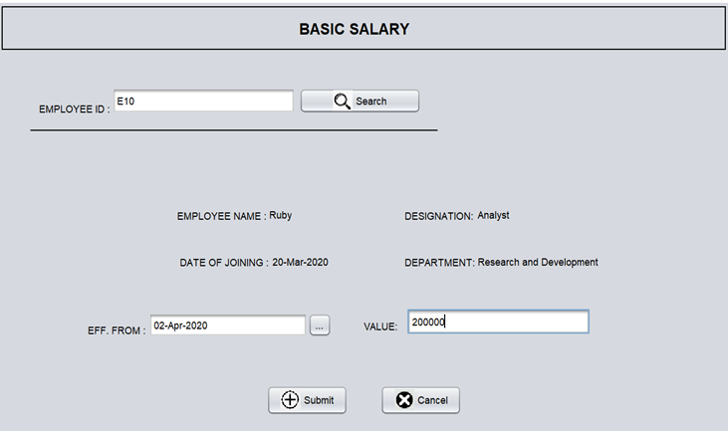
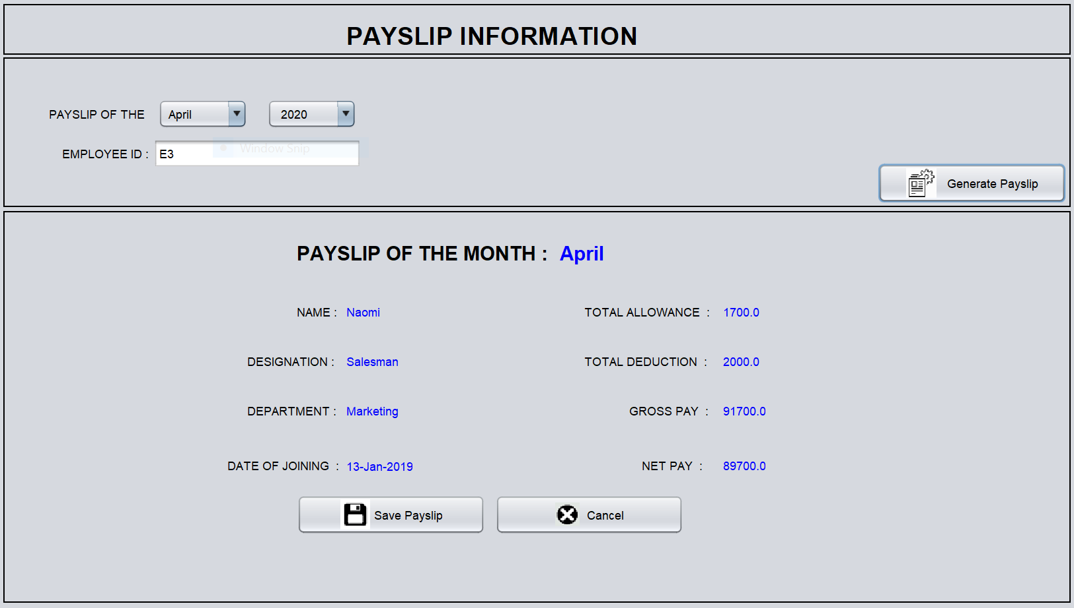

Slide 8
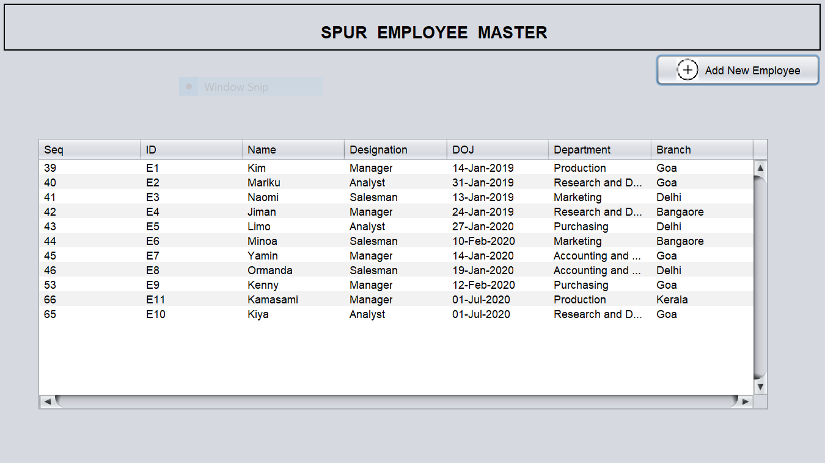
Employee Records

Slide 9
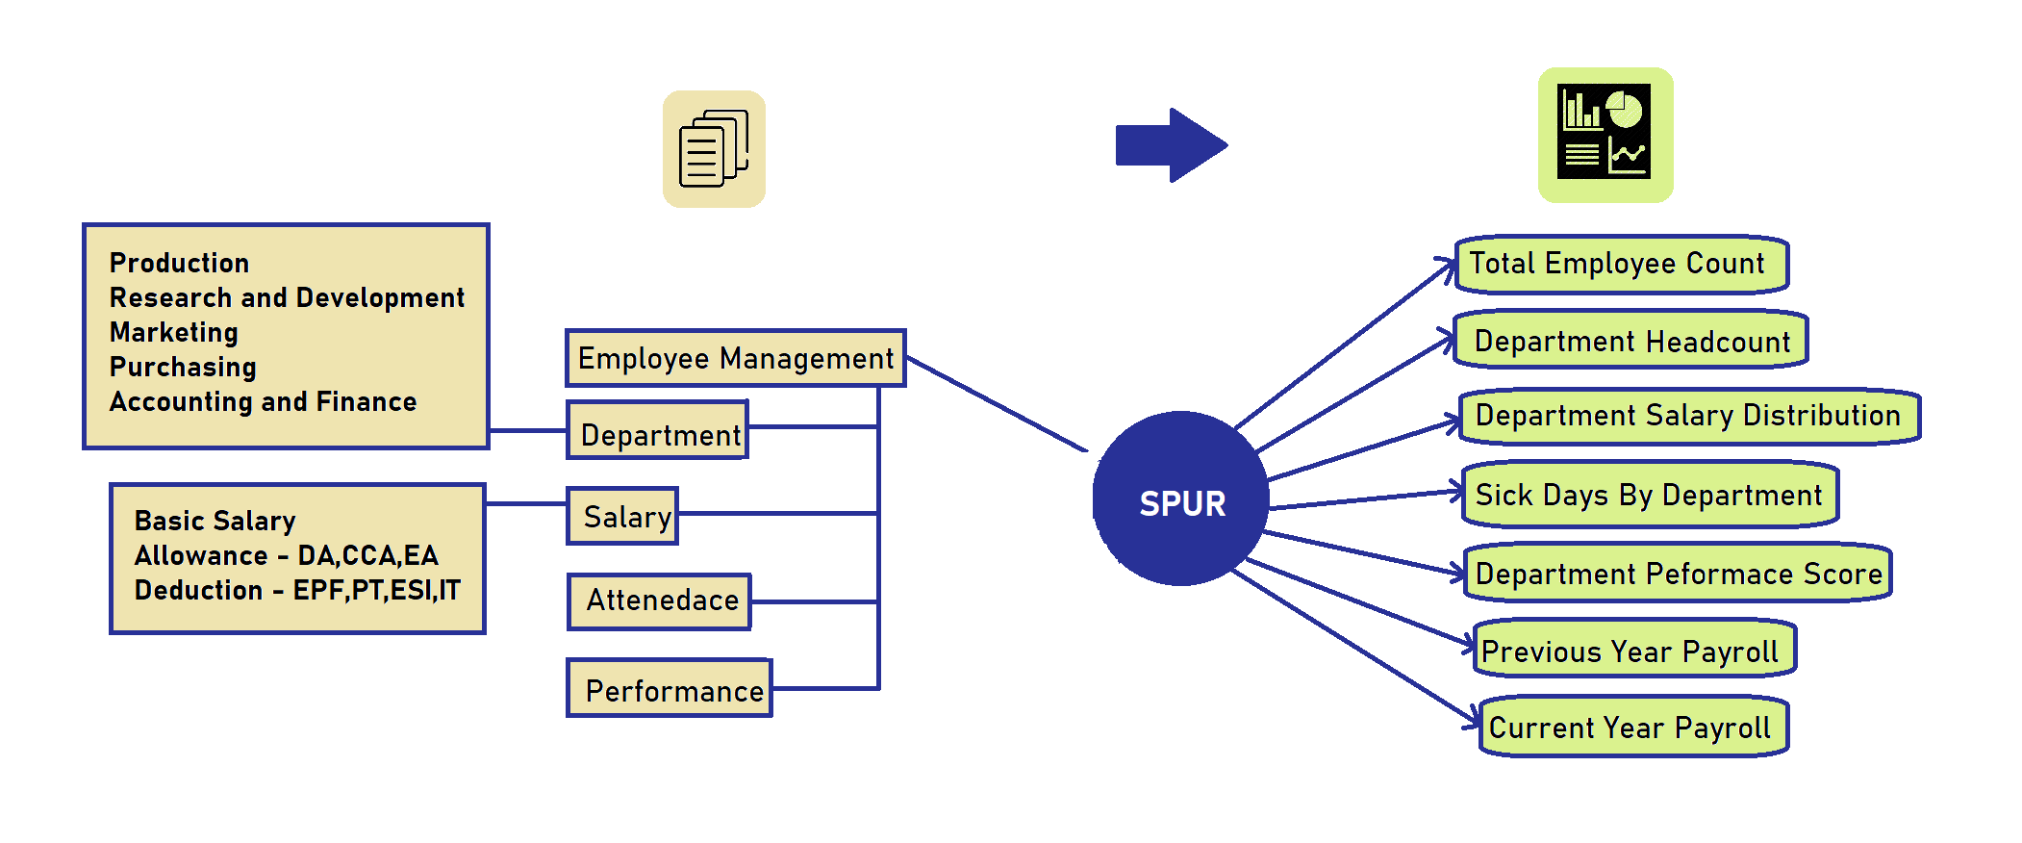
Data Flow Diagram

Slide 10
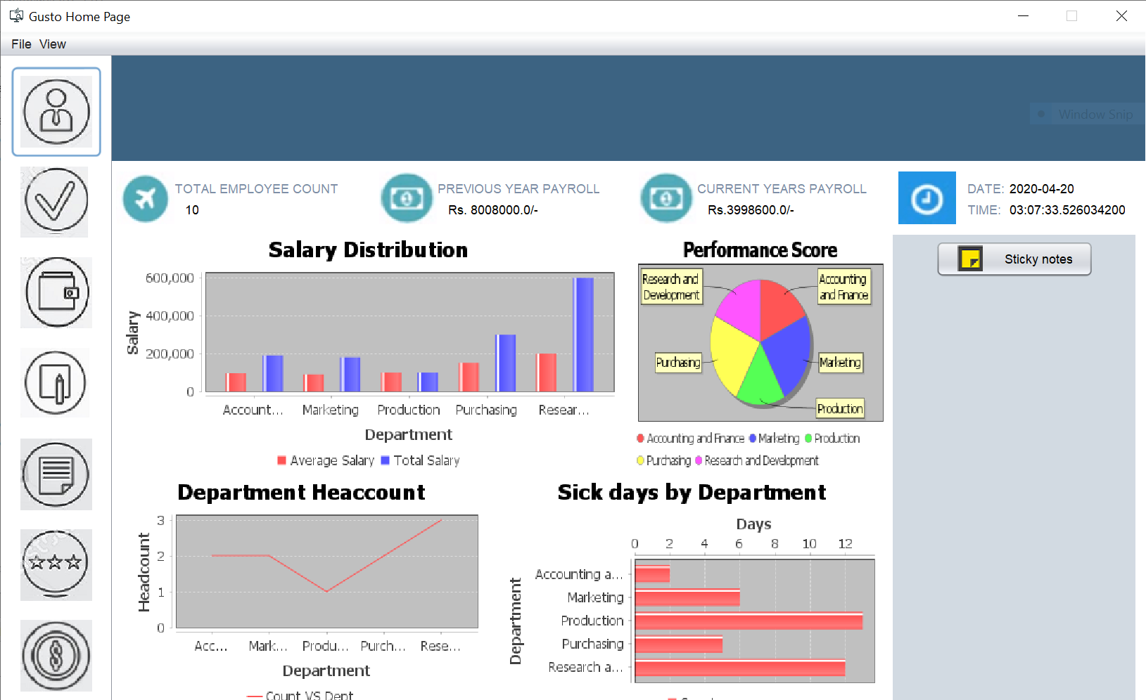
Live DASHBOARD

Slide 11
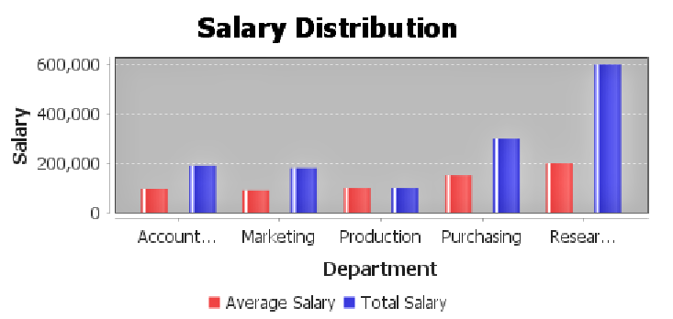
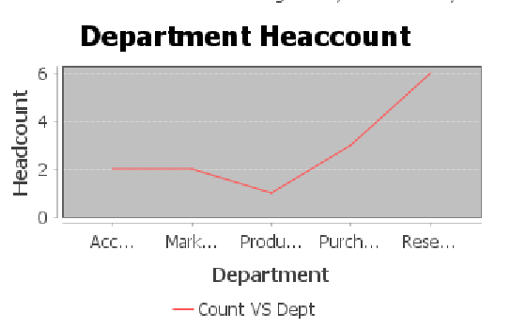
SALARY DISTRIBUTION
Organizations target employee pay at either the average rate to ensure employees receive competitive compensation while the business is still managing overall costs. However, knowing why average salaries differ is also important, as it may drive different compensation decisions in your organization.
DEPARTMENT HEADCOUNT
Its essential to ensure an organization has the right number of people with the right skills in the right roles so the company can execute on its business strategy.

Slide 12
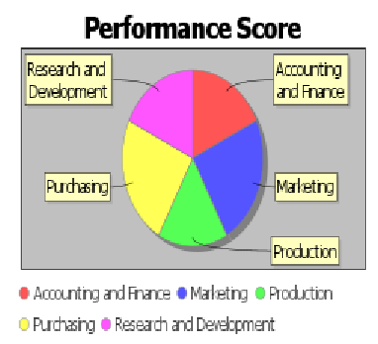
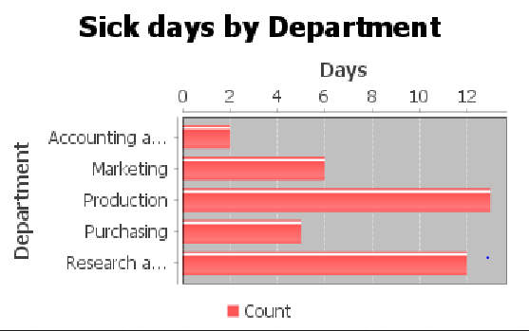
PERFORMANCE SCORE
Managers continually monitor the performance. Underperformance provides an early warning of potential problems and allowing managers to know when they must make adjustments to keep a business on track.
SICK DAYS BY DEPARTMENT
It allows to track how regular the employees are in department and also to know about the employees taking leave without any reason.

Slide 13
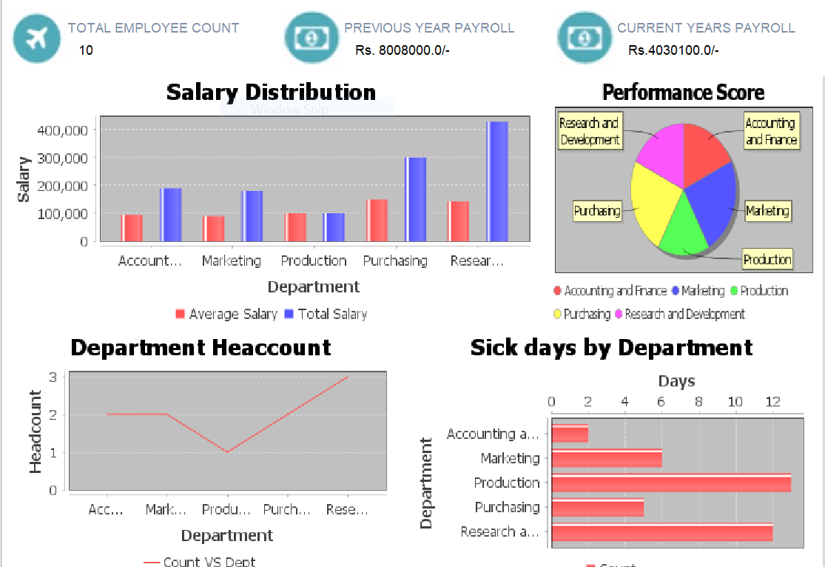
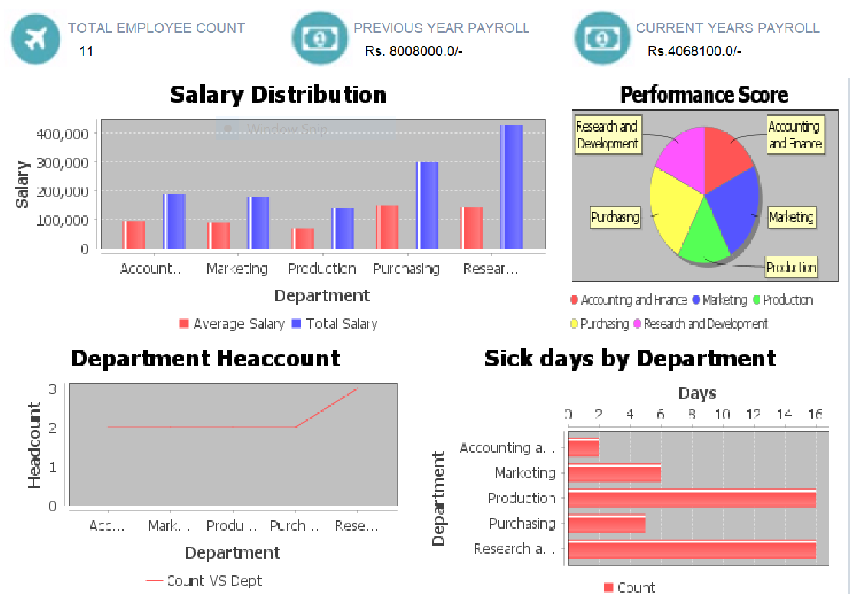
Analysis of 10 Employees
Analysis of 11 Employees

Slide 14
Objective Achieved
The Concept of Inheritance is used to inherit various built-in classes in Java like Jtoolbar ,JMenuBar.
Exceptions are handled by adding try and catch blocks in all the places needed.
Multithereading is implemented using Runnable interface to display the current date and time.
The Front-End is built using Java Swing. The javax.swing package provides classes for java swing API such as JButton, JTextField, JTextArea, JRadioButton, JCheckbox, JPanel etc.
Wamp Server is used in order to view the backend database.
In this project, tables are created in the backend in order to store the employees records, their attendance, performance, allowance, deduction information which is used to calculate their net pay and gross pay .

Slide 15
Conclusion
From this mini project I understood the need of Java in the modern day , where we need to find a logic and code a program for real time problems. Being an Computer Science Engineer it is not just knowing concepts of Java ,but to understand the depth of the program coded

Slide 16
THANK YOU

